Slide 1
Two-Way-Dot Chart
MidTerm Teaching Presentation.
Isaac Kobby Anni • 10.22.2024 • Data Science, Ph.D

Slide 2
Presentation Contents
Overview
Introduction
Trellis Graphics
Comparison (Lattice vs Ggplot2
Conclusion

Slide 3
Overview
Chapter 8.5 - visualizing Multivariable Data

Slide 4
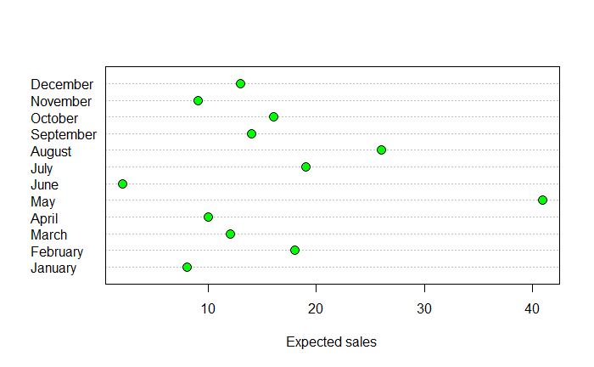
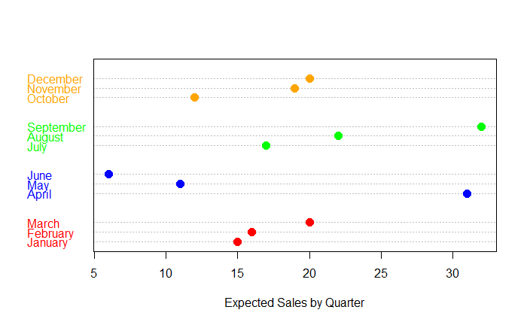
Overview

Slide 5
Introduction to Two-Way-Dot Chart.
Key Takeaways
Introduced by Cleveland (1985)
Designed for comparing two categorical variables.
Eg: Hair & Color data (Table 8.1)
Each point represents a specific combination of the two variables.
Used to visualize distributions and frequencies across two dimensions (2 variables).

Slide 6
Trellis Graphics Overview
Facts.
Trellis graphics is the implementation of multi-variable data in R using the lattice package.
Developed to handle complex multi-variable data more easily.
Used to visualize categorical data relationships.

Slide 7
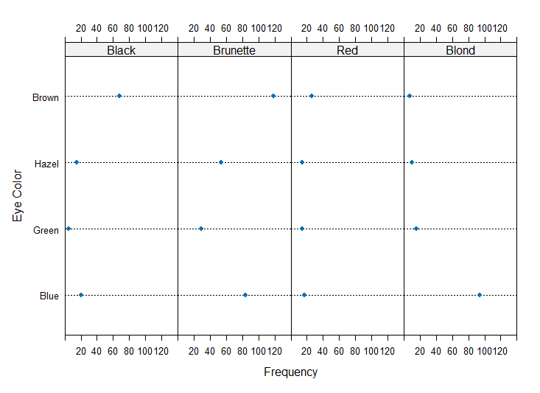
Trellis Plot- Horizontal Layout

Slide 8
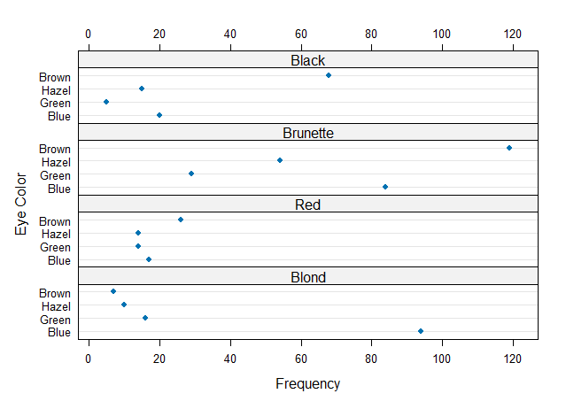
Trellis Plot- Vertical Layout

Slide 9
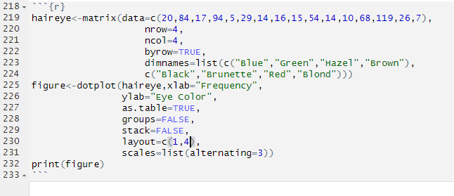
Trellis Plot - Code Snippet

Slide 10
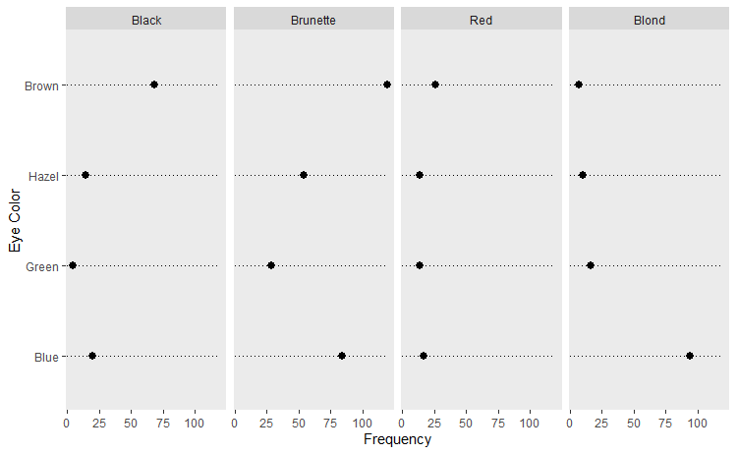
Ggplot2 - Horizontal Layout

Slide 11
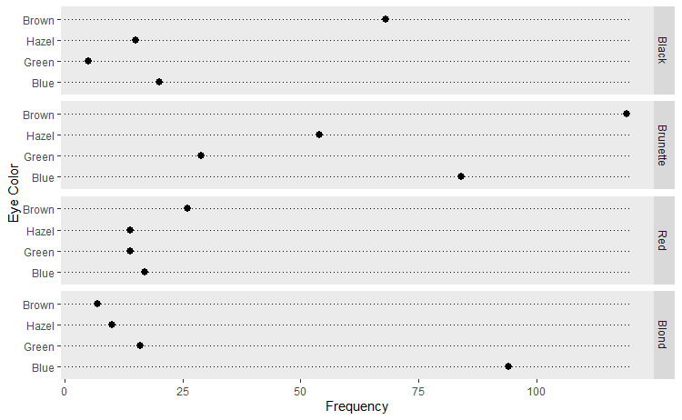
Ggplot2 - Vertical Layout

Slide 12
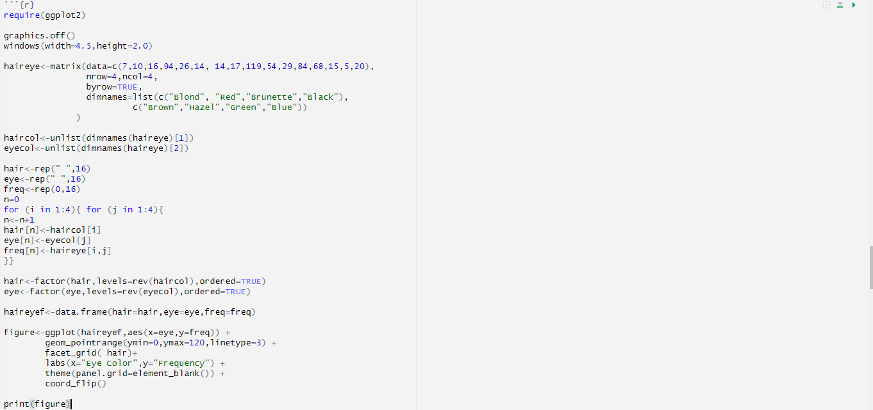
Ggplot2 - Code Snippet

Slide 13
Comparison of Lattice & Ggplot2
Lattice
Less flexible
Used in Trellis
Modification Restricted to Trellis usage
Ggplot2
More flexible
Standalone
Depends on Ggplot2 flexibility

Slide 14
Challenges & Best practices
Challenges
Horizontal Dot Chart compresses the x - axis.
Ggplot2 requires more detailed coding to achieve desired layout
Best Practices
R graphics package is simple and easy for two-way-dot chart
Vertical layout is gives good layout for presentation.

Slide 15
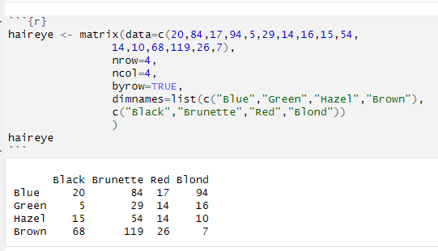
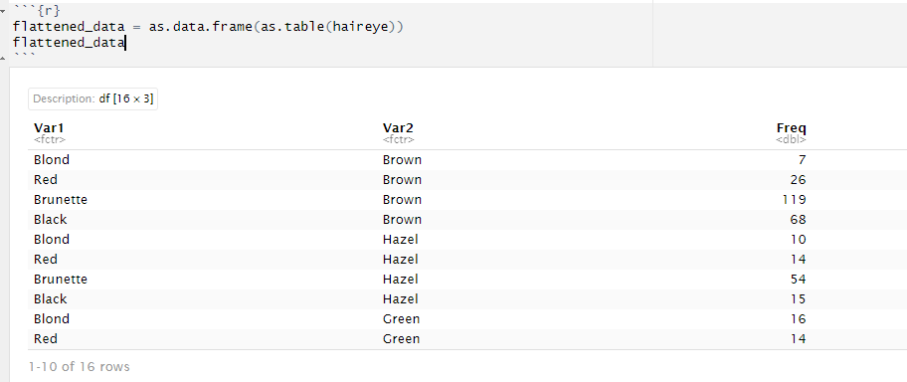
Appendix - Flattened Rep.

Slide 16
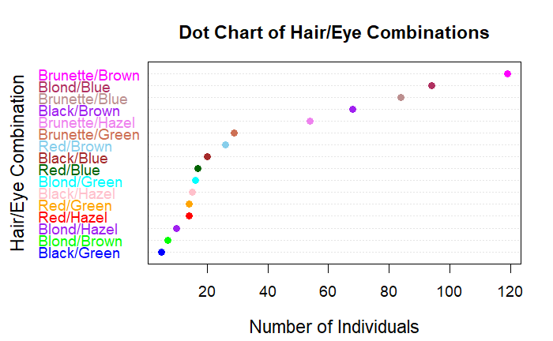
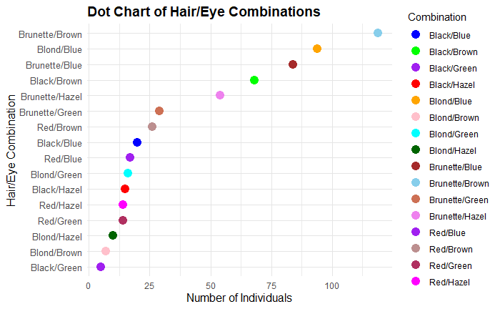
R graphics vs Ggplot2 for flattened data

Slide 17
Questions?

Slide 18
Thank you for your attention.

